Slide 1

Sensitivity and Robustness
MTH 564 – Mathematical Modeling

Slide 2
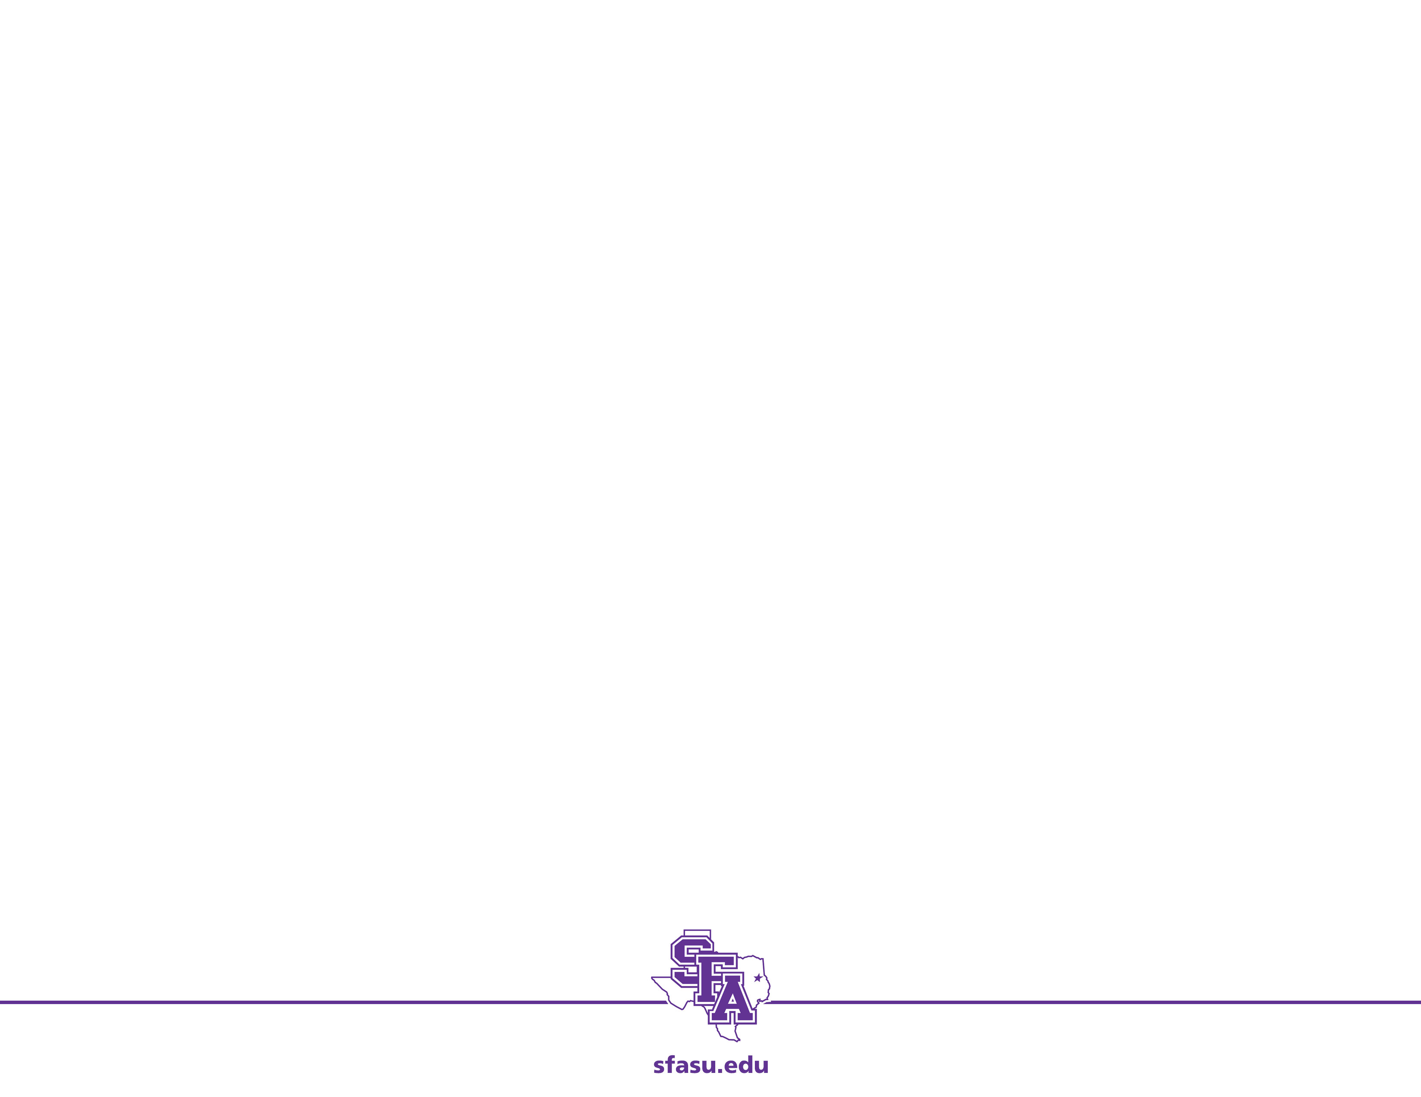
Robustness
Definition. A mathematical model is robust if the conclusions the model leads to remain valid even though the model is not completely accurate.
In the real world we never have perfect information. Thus, it is necessary to consider robustness in any mathematical modeling project.
Sensitivity Analysis allows us to gauge the robustness of the model with respect to the assumptions about the data.
What about the other assumptions? It is the job of the modeler to ensure that the assumptions do not invalidate the results of the modeling process.

Slide 3
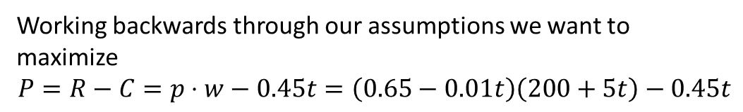
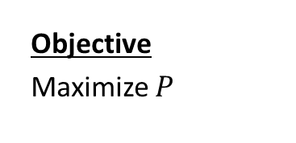
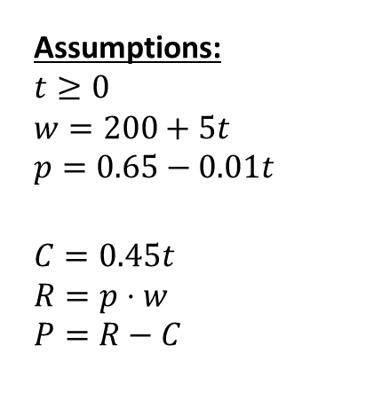
Our Model
Variables:
t – time (in days)
w – weight of pig (lbs.)
p – price for pigs ($/lb.)
C – cost of keeping pig
R – revenue obtained by selling the pig
P – profit
Assumptions:
$$t≥0$$
$$w=200+5t \\ p=0.65−0.01t$$
$$C=0.45t \\ R=p⋅w \\ P=R−C$$
Objective
Maximize $P$
Constants (Measurements):
200 – starting weight of pig
5 – rate of change of pig’s weights
$0.45 – cost per day
$0.65 – price per pound
$0.01 – amount the price decreases per day
Working backwards through our assumptions we want to maximize
$$P=R−C=p⋅w−0.45t=\left(0.65−0.01t\right)\left(200+5t\right)−0.45t$$
Besides the measurements, what other assumptions did we make in using this model?

Slide 4
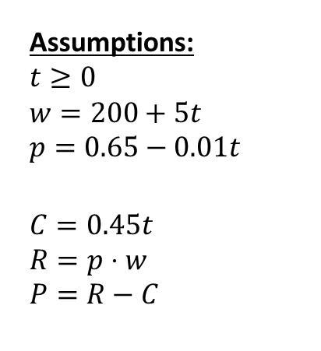
Assumptions
Assumptions:
$$t≥0$$
$$w=200+5t \\ p=0.65−0.01t$$
$$C=0.45t \\ R=p⋅w \\ P=R−C$$
The two big assumptions we make are
The weight of the pig is a linear function of time.
The selling price of the pig are is a linear function of time.
Do these make sense? For how long?
Notes:
A 100 days from now we have w = 700 and p = -0.45?

Slide 5
Practical Considerations
Assumptions:
$$t≥0$$
$$w=200+5t \\ p=0.65−0.01t$$
$$C=0.45t \\ R=p⋅w \\ P=R−C$$
Practical Things to Consider
Can we get enough data to model the pig’s weight changes or the future changes in price?
Is it possible to sell the pig at anytime (in the middle the night, for instance)?
What if our critical value is irrational?

Slide 6
Goal
Can our model be correct if the assumptions are wrong?
For the pig problem, in the short term yes, in the long term no
It is near impossible to have a perfect model. However, we strive toward perfection.
Goal: Create a robust model. That is, a model that is useful in a real-world context (not necessarily a perfectly correct model).

Slide 7
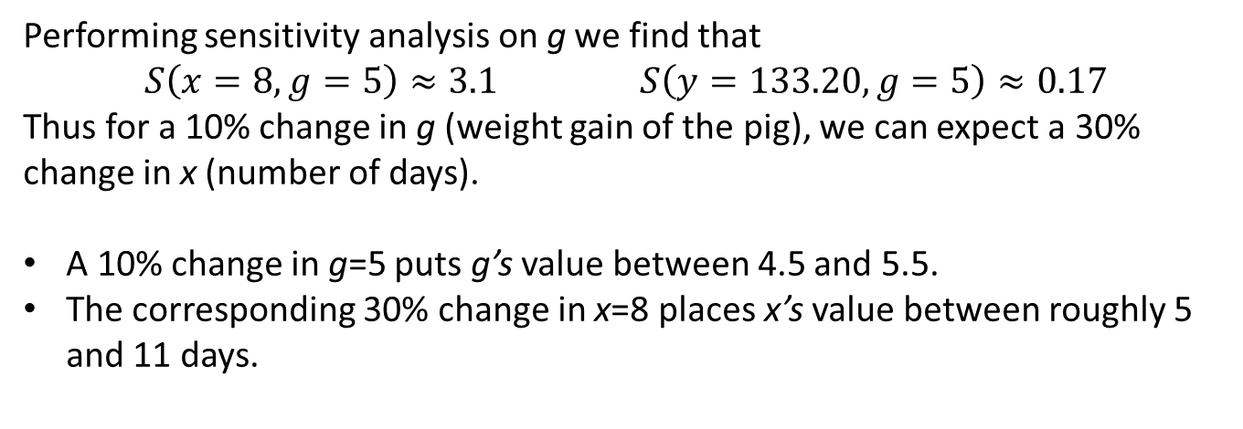
Broader Interpretation: A look at g
Performing sensitivity analysis on g we find that
$$S\left(x=8,g=5\right)≈3.1 S\left(y=133.20, g=5\right)≈0.17$$
Thus for a 10% change in g (weight gain of the pig), we can expect a 30% change in x (number of days).
A 10% change in g=5 puts g’s value between 4.5 and 5.5.
The corresponding 30% change in x=8 places x’s value between roughly 5 and 11 days.
Value of g | Optimal Profit | Profit at 8 Days | Difference
4.5 | $131.25 | $130.92 | $0.37
5.0 | $133.20 | $133.20 | $0.00
5.5 | $135.75 | $135.48 | $0.27
Note: Even if our value of g is off by 10% the profit lost is less than $0.40.
Python File:
section1-2-sensitivity-g.py

Slide 8
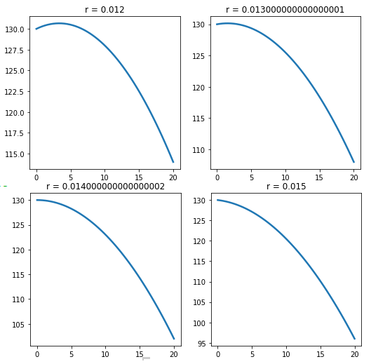
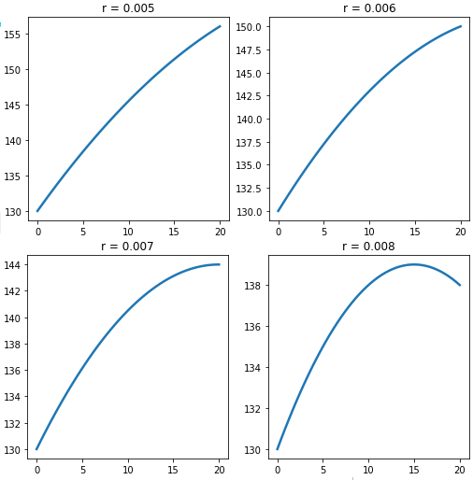
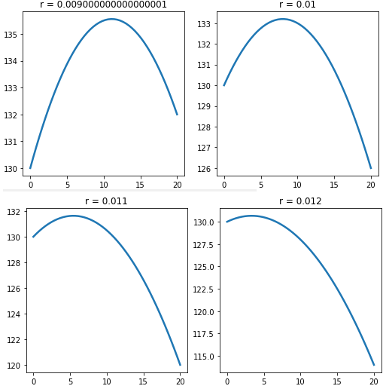
Graphs of Profit for different values of r
r | x
0.005 | 36.0
0.006 | 26.667
0.007 | 20.0
0.008 | 15.0
0.009 | 11.111
0.010 | 8.0
0.011 | 5.455
0.012 | 3.333
0.013 | 1.538
0.014 | 0.0
0.015 | -1.333
Notes:
Refer to if needed

Slide 9
Broader Interpretation: A look at r
If we feel that r = 0.01 is a best case scenario:
Notice values of r ≥ 0.014 dictate we should sell now.
To be safe we should probably recommend rechecking the model parameters (and the model) each day until we sell.
r | x
0.005 | 36.0
0.006 | 26.667
0.007 | 20.0
0.008 | 15.0
0.009 | 11.111
0.010 | 8.0
0.011 | 5.455
0.012 | 3.333
0.013 | 1.538
0.014 | 0.0
0.015 | -1.333
If we feel that r = 0.01 is a worst case scenario:
Notice small values of r dictate we wait a long time. But, our model is not valid our a long time.
To be safe we should probably keep the pig for a week, recheck our parameters, and start over.
Notes:
Python File:
section1-2-sensitivity-g.py

